Slide 1

The Dangers of unmonitored internet access for children
Presented by Foothill Family
Notes:
Welcome
Introductions
We are very pleased to partner with the Rosemead School District to present this presentation on the Dangers of Unmonitored Internet Access for Children. This presentation was originally developed for parents of high school students, so we have revised it, but there may be sensitive content that is new to you.

Slide 2
Appropriate amount of screen time
Kids and teens 5 to 18 years: Parents should place consistent limits on screen time, which includes TV, social media, and video games.
It is important for parents to assist their children have limits if their child has not developed the impulse control to keep to it on their own.
Media should not take the place of getting enough sleep and being physically active.
Not all screen time is “created equal”. It's up to parents to decide how (and how often) their teens use screens and whether screen time is positive or negative. For instance, time spent on homework or other educational activities might not need to be as restricted as time spent playing video games.
Notes:
Carefully explain screen time. Some parents may not understand what children of different ages like. Younger kids like Youtube etc. and older ones may prefer social media and gaming. Also explain that these can be viewed on smartphones, tablets, televisions and other devices. Also explain that these can be viewed on smartphones, tablets, televisions and other devices.
https://kidshealth.org/en/parents/?search=y&q=tv&datasource=kidshealth&lang=english&start=0&section=parents_teens_kids

Slide 3
Appropriate amounts of screen time by age
Babies and toddlers up to 18 months old: | No screen time, with the exception of video-chatting with family and friends.
Toddlers 18 months to 24 months: | Some screen time with a parent or caregiver.
Preschoolers: | No more than 1 hour a day of educational programming, together with a parent or other caregiver who can help them understand what they're seeing.
Kids and teens 5 to 18 years: | Parents must set limits consisting of screen time, which includes TV, social networks, and video games. They should have time to get enough sleep and be physically active.
Notes:
https://www.aap.org/en-us/about-the-aap/aap-press-room/Pages/American-Academy-of-Pediatrics-Announces-New-Recommendations-for-Childrens-Media-Use.aspx
https://kidshealth.org/en/parents/?search=y&q=tv&datasource=kidshealth&lang=english&start=0&section=parents_teens_kids
Not all screen time is “created equal”. It's up to parents to decide how (and how often) their teens use screens and whether screen time is positive or negative. For instance, time spent on homework or other educational activities might not need to be as restricted as time spent playing video games.

Slide 4
Effects of too much screen time
Brain Development
Obesity
Irregular sleep schedules and shorter duration of sleep
Behavioral problems
Loss of social skills
Violence
Less time for play
Notes:
https://www.mayoclinic.org/healthy-lifestyle/childrens-health/in-depth/screen-time/art-20047952

Slide 5
Reduce Screen Time
Health experts say screen time at home should be limited to two hours or less per day.
Parents or caregivers can set rules that limit computer time, TV watching, and use of video games to reduce how much time is spent in front of a screen.
Make screen time a Reward, not a routine
Studies suggest that when parents set rules for the amount of media usage, children’s media use is almost three hours lower per day.
What might be some other benefits of limiting screen time not mentioned ?
Notes:
Please stop and ask audience members to give you examples of what might be some other benefits of limiting screen time not mentioned today?
https://www.nhlbi.nih.gov/health/educational/wecan/reduce-screen-time/index.htm

Slide 6
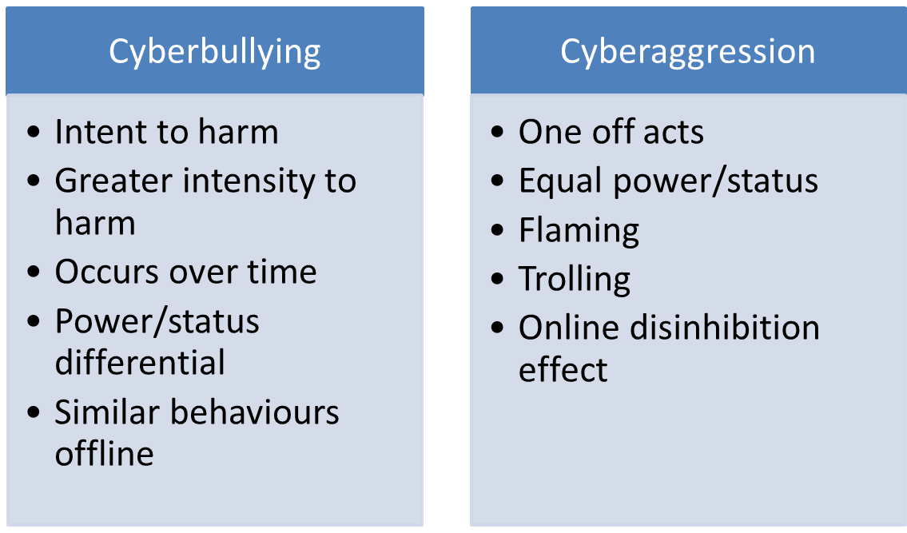
Cyberbullying
https://resourcelinkbce.wordpress.com/2013/07/19/cybersafety-with-great-power-comes-great-responsibility/
Notes:
Cyberbullying is bullying or harassment that happens online.
It can happen in an email, a text message, a game, or on social networking site.
It might involve spreading rumors or images posted on someone’s profile or passed around for others to see, or creating a group or page to make a person feel left out.

Slide 7

Help prevent cyberbullying
Talk to your kids about bullying; tell your kids they can’t hide behind the words they type and the images they post.
Hurtful messages not only make the target feel bad, but also makes the sender look bad.
Recognize the signs of cyberbullying
https://study.com/academy/lesson/how-to-start-an-anti-bullying-campaign.html

Slide 8
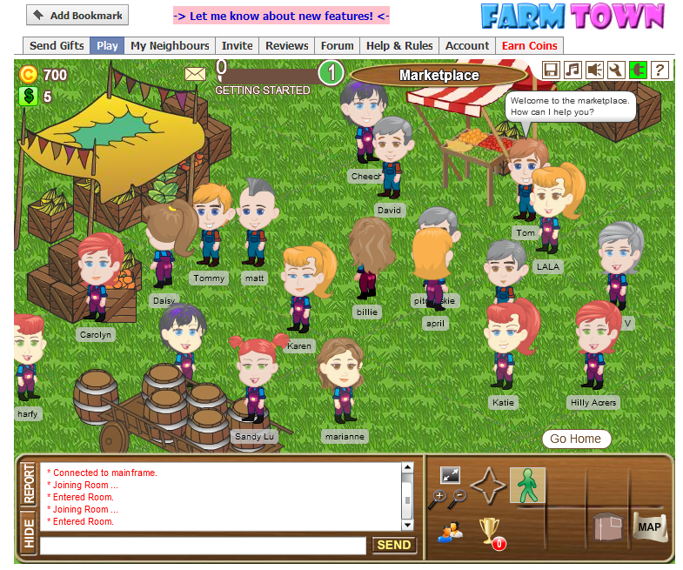
Kids and virtual worlds
Virtual worlds are computer-simulated online “places” where people use avatars- graphic characters- to represent themselves.
Some virtual worlds are intended for children; there are built-in protections to keep their experience age appropriate.
Others are designed for adults.
Photo from http://www.raphkoster.com/2010/02/26/are-virtual-worlds-over/
Notes:
Many virtual worlds say they’re for adults only and try to verify that visitors are over 18 before allowing them to enter.
However, a posted age requirement may not stop kids from finding their way.
Virtual worlds can be accessed in various ways; some are massive, multi-player games, often accessed through gaming console.
Others are online communities where avatars’ activities rely on their uses’ imaginations.

Slide 9

Talk to your kids and stay engaged
The anonymity that avatars provide can encourage people to “act out” behaviors that may be considered inappropriate.
Visitors may find the online equivalent of a red-light with simulated sexual activity or violence.
Photo from http://hrdevelopmentinfo.com/staying-connected-how-social-media-is-changing-adult-learning/
Notes:
What websites are your kids going to online?
And how they are getting there?
Help them understand that personal information about themselves, family members, and friends should stay private.
Check out what kind of virtual sites your child is visiting. Get to know what’s on site, the privacy protection it offers, and how it verifies the age of site visitors.
Watch for changes in their patterns of behavior that could indicate an obsession

Slide 10

Online Predators
Many predators are hiding behind their computer screens; they can lure in children and vulnerable teens by posing as their peers.
Predators are very cunning and maybe trying to find kids that they can convince to meet up with them.
They may send them inappropriate content over the internet.
They may also try to get personal information out of a child (like home address or social security number).
https://onlinegrooming-comenius.blogspotcom/
Notes:
Disclaimer: This content was originally developed for high school parent workshops, so it may be newer information to you. There may be sensitive content that you will have questions about. Please feel free to ask questions.
We often think of predators lurking around in the real world, stalking kids, or following them home from school.
Online Predators have direct access to unsuspecting children via e-mail, instant messaging, social networking sites, and chat rooms simplifying the predator’s efforts to contact and groom children.
Predators create situations where children feel they owe them something or do not want to “disappoint” them. Additionally, some teens are placing themselves at risk and willingly talk about sexual matters with online acquaintances.
A predator often engages in activities involving children and appears trusting to both parents and children. They may try to develop trust and secrecy by listening to a child and sympathizing with the child’s problems and insecurities. Often they flatter and compliment excessively, offer gifts or money.

Slide 11

Warning signs
Becomes secretive about online activities
Becomes obsessive about being online
Gets angry when he or she can’t get online
Receives phone calls from people you do not know or makes calls to numbers that you do not recognize
Receives gifts, mail, or packages from someone you do not know
Withdraws from family and friends
Changes screens or turns off computer when an adult enters a room
Begins downloading/viewing pornography online
http://freepngimages.com/yellow-caution-sign-health-safety-sign/

Slide 12

Who do traffickers target?
Teens (both boys and girls) between the ages of 12-19 are victims, but some have been as young as 9.
Teens from all different socioeconomic and ethnic backgrounds are targets
Traffickers often seek out children online who appear vulnerable, depressed, seem emotionally isolated from family and friends, have low-esteem or appear to have a lot of unsupervised time.
Runaway and homeless youth, as well as victims of domestic violence, sexual assault, war or conflict, or social discrimination are frequently targeted by traffickers.
http://floridapolitics.com/archives/230372-human-trafficking-cases-increase-50-percent-florida

Slide 13
How can I protect my child?
Look for at-risk warning signs (staying out later than usual, change in friends, withdrawing from activities, spending time with suspicious individuals, unexplained possessions/access to money)
Supervise them
Know: their friends, where they are, when they are coming home, do a spot check
Implement the guidelines contained in Enough Is Enough®'s "Rules 'N Tools" to protect Internet-enabled devices.
To report a tip or get help, contact the National Human Trafficking Hotline at 1-888-373-7888. In the event of an emergency, call 911.
Notes:
Spot check when they are out with friends… drop in and say I came to drop off your sweater its cold, etc.…

Slide 14
How to talk to your kids about internet predators
Parents need to:
Pay attention to what your kids are doing online, and ask your child non-threatening questions.
Avoid over-reacting if your kids have been talking to people they don’t know online or if they admit that they’ve come across a dangerous or tricky situation online.
Ask “Has an online stranger….
Tried to befriend you? If so, how do you know this person?”
Talked to you about sex?”
Asked you for personal information?”
Asked you for pictures? Sent you pictures?"
Said anything to make you feel uncomfortable?”
Offered to send you gifts?”
Notes:
Communication is key in protecting children from online exploitation. One way to keep children safer is to supervise their online activities or limit their access to sites that can facilitate online interactions with people they don’t know and trust.
If you allow your child access to these sites, you should discuss internet safety often.

Slide 15
Sharing Personal Information
Identity theft; much of our personal information is now easily accessible on the web.
Children can easily mistake a scam website for a legitimate one, and could end up disclosing personal information.
Children should always ask an adult for permission before signing up for a website or downloading an app. program to the computer, tablet, or mobile device.
Notes:
Disclosing personal information: they may think they are signing up for an app or membership to a kid-friendly site, and it could simply be a ploy to get them to enter their parents credit card info, address email, etc.

Slide 16

Talk to your kids
Inappropriate conduct: The online world can feel anonymous. Communicating to children that they are still accountable for their actions.
Inappropriate contact: Some people online have bad intentions, including bullies, predators, hackers, and scammers.
Inappropriate content: concerns that your children could find pornography, violence, or hate speech online.
Photo from https://www.shutterstock.com/image-vector/puzzle-people-icon-vector-illustration-eps10-374303356
Notes:
You can reduce these risks by talking to your kids about how they communicate- online and off- and encouraging them to engage in conduct they can be proud of.
Advice for parents:
RESIST the urge to get angry with your child when discussing this
Behave in a way that will cause your child to feel at ease to share with you.
Behave in a way that gives your child permission (confidence) to talk to you.

Slide 17

Talk early and often
Start early: As soon as your child is using a computer, a cell phone, or any other mobile device, it’s time to talk to them about online behaviors, safety, and security.
Initiate conversation: Don’t wait for them to start the conversation. Use everyday opportunities to talk to your kids about being online.
https://aecrm.wordpress.com/2018/04/18/living-life-to-the-fullest/
Notes:
Research suggests that when children want important information, most rely on their parents.
Initiate conversation: For instance, a TV program featuring a teen online or using a cell phone can initiate a discussion about what to do or not to do in similar circumstances.

Slide 18

Create an honest, open environment
Be supportive and positive
Listening and talking their feelings into account helps keep conversation afloat.
You may not have all the answers and being honest about that can go a long way.
Communicate your values
Be patient
Photo from https://amormagazine.co.uk/development-in-a-relationship/
Notes:
Communicate your values: Be upfront about your values and how they apply in an online context. Help your children make thoughtful decisions when facing tricky situations.

Slide 19
Where to self help: Cyber Tip Line
TO REPORT CHILD PORNOGRAPHY, OBSCENITY, OR TO REPORT A CYBERCRIME: www.cybertipline.com
Or call: 1-800-THE-LOST (provided by the National Center for Missing and Exploited Children). The congressionally mandated CyberTipline is a reporting mechanism for cases of child sexual exploitation including child pornography, online enticement of children for sex acts, molestation of children outside the family, sex tourism of children, child victims of prostitution, and unsolicited obscene material sent to a child. Reports may be made 24 hours per day, 7 days per week.

Slide 20
Where can you get help?
211 LA County Information- DIAL 211
Referral Services
www.healthycity.org
Foothill Family Service Intake
(626) 993-3000
Notes:
Seek Help
Psychotherapy sessions provide a safe place to express feelings
A skilled therapist will help teens learn healthy and productive ways to cope with painful feelings and other challenges in their life. Therapy sessions may be one-on-one and/or done in small groups.
Family therapy will help each family member, including the teen, address issues that causes strife. In addition, the therapist will teach family members how to provide appropriate support.
Where can you get help and information?
Foothill Family –what we offer
Foothill Family Contract with EMUHSD – also covers individual treatment and group treatment for EMUHSD students. Ask your child’s guidance counselor to refer you.
Foothill Family’s MediCal Contract –school based treatment
Private Insurance- talk with your primary care physician or call the number on your insurance card for more information
211- for more information on all kinds of community services

Slide 21

Questions
Please fill out the survey and let us know your opinion

Slide 22
References
https://www.consumer.ftc.gov/topics/protecting-kids-online
https://www.familyorbit.com/blog/how-to-keep-your-family-safe-online-and-off/
https://internetsafety101.org/
http://www.eliberare.com/en/2015/05/4-methods-traffickers-use-to-recruit-their-victims-keep-your-eyes-wide-open/
https://abcnews.go.com/Primetime/story?id=1596778&page=1
https://kidshealth.org/en/parents
https://www.aap.org/en-us/about-the-aap/aap-press-room/Pages/American-Academy-of-Pediatrics-Announces-New-Recommendations-for-Childrens-Media-Use.aspx
http://api.missingkids.org/cybertipline https://kidshealth.org/en/parents
https://www.nhlbi.nih.gov/health/educational/wecan/reduce-screen-time/index.htm
https://www.mayoclinic.org/healthy-lifestyle/childrens-health/in-depth/screen-time
Notes:
The information for this presentation is from the websites listed on this page.

